Slide 1
University Of Sargodha
CS & Information Technology
Project Of SNA:-
Simple network management protocol (SNMP)
Submitted To :-
Sir Waseem Ahmad

Slide 2
Groups Members:
Name: Aqsa Qaisar
Roll No: BSITF19M032
Name: Sadia Arif
Roll No: BSITF19M039
Name: Nimra Nazeer
Roll No: BSITF19M014

Slide 3
Simple Network Management Protocol (SNMP)
Our Today’s Topics
What is SNMP
History
Key Components
SNMP PDU
SNMP Ports
Community Strings
Polls and Traps
SNMP Implementation

Slide 4
What is SNMP?
Internet Standard protocol for collecting and organizing information about managed devices on IP networks and for modifying that information to change device behavior.
Example
You can use SNMP to shut down an interface on your router or check the speed at which your Ethernet interface is operating.
SNMP can even monitor the temperature on your switch and warn you when it is too high.

Slide 5
History Of SNMP
In 1989
SNMP was adopted as TCP/IP based internet standards.
In1991
Supplement to SNMP to include management task of LAN and LAN devices
In 1995
SNMP V2:
Functional enhancement To SNMP
SNMP on OSI base Networks
In 1998
SNMP V3
Further enhancement
Security capability for SNMP
SuSNMPv2
Functional enhancements to SNMP
SNMP on OSI-based networks
pplement to SNMP to include management of LAN and LAN devices
Supplement to SNMP to lude management of LAN and LAN devices
Supplement to SNMP to include management of LAN and LAN devices

Slide 6
3 Key Components
Functional enhancements to SNMP
SNMP on OSI-based networks
Managed Devices
The managed devices can be any type of device, including, but not limited to, routers, access servers, switches, cable modems, bridges, hubs, IP telephones, IP video cameras, computer hosts, and printers
2. Agents
An agent is a network-management software module resides on a managed device.
An agent has local knowledge of management information and translates that information to or from an SNMP-specific form.

Slide 7
3. NMS
Also called managers.
Server running some kind of software system that can handle management tasks for a network

Slide 8
Polls and Traps
Polls
A poll, in the context of network management, is the act of querying an agent (router, switch, Unix server, etc.) for some piece of information.
Traps
A trap is a way for the agent to tell the NMS that something has happened.
Traps are sent asynchronously, not in response to queries from the NMS.

Slide 9
Relationship between NMS and Agent
For example, when your T1 circuit to the Internet goes down, your router can send a trap to your NMS. In turn, the NMS can take some action, perhaps paging you to let you know that something has happened
NMS
Agent

Slide 10
Management Information Base(MIB)
SNMP protocol provide information about devices and that variables information is provided by management information base(MIB).
It is collection of objects and their types in hierarchal tree format.
Oid (object identifier)

Slide 11
Structure of Management Information (SMI)
SMI:-
SMI defines rule for naming objects, defining object types and showing how to encode objects and data.

Slide 12
Ports
01. Agent will receives request on port no. 161 and manager will send request on port no. 161
02. Manger receives notifications from agent on port no. 162 that called trap event.

Slide 13
Community strings
A successfully decoded SNMP request is authenticated using the community string
SNMPv1 and SNMPv2 use communities to establish trust between managers and agents
Most agents support three communities
read-only
read-write
Trap

Slide 14
Versions of SNMP
SNMP v1, v2
No username
Use community string
No encryption
SNMP v3
Username + password
Encryption
secured

Slide 15
PDUs (Protocol Data Unit)
Get Request
It is sent from manager to the agent.
It is used to retrieve the value of MIB objects
GetNext Request
It is sent from the manager to the agent
it is used to retrieve the value of next MIB objects in sequence or table
Get Bulk Request
It is sent from the manager to the agent
Request multiple getnext request and return it all in a single response
Set request
It is sent from the manager to the agent
It is used to set(store) value of MIB object

Slide 16
Response
It is sent from an agent to manager
It is response to Get Request or Get Next Request.
It contains the value(s) of the variable(s) requested by manager.
Trap
It is sent from agent to manager to report an event.
For example if the agent is rebooted it inform the manager and reports the time of rebooting.
Inform Request
It is sent from agent to manager
Acknowledge asynchronous notification
Report
The Report PDU is designed to report some types of errors between managers.
It is not yet in use.

Slide 17
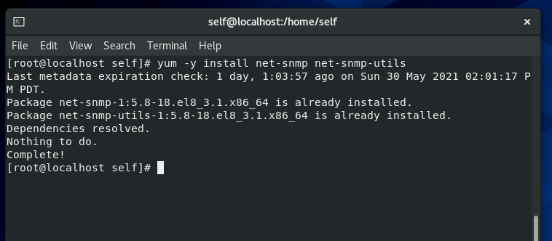
Install
Command
yum -y install net-snmp net-snmp-utils
01

Slide 18
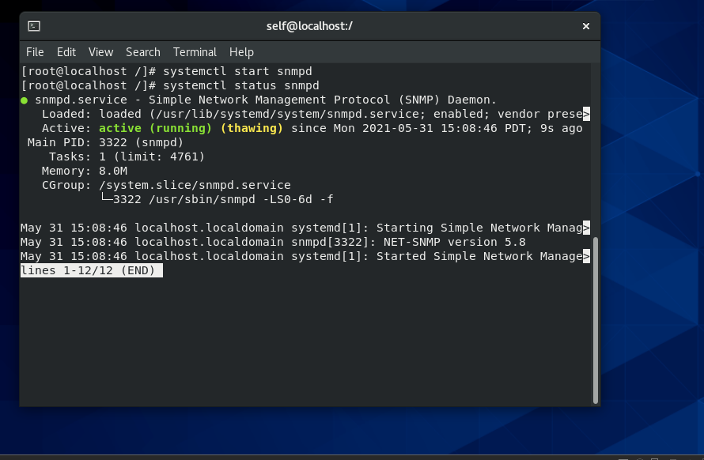
Start Services
Start Services
systemctl start snmpd
02

Slide 19
Check
Status
Start Services
systemctl status snmpd
03

Slide 20
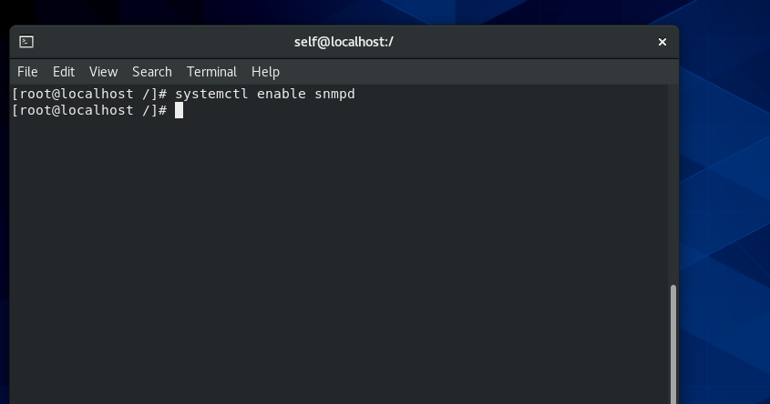
Enable
Services
Enable Services
systemctl enables snmpd
04

Slide 21
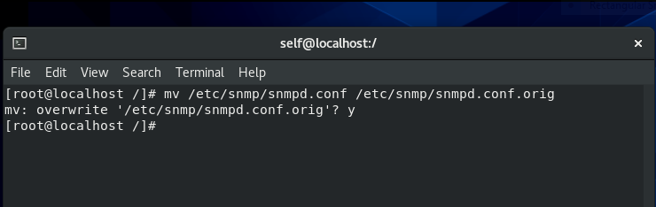
Move Config File
Move Configuration files
mv /etc/snmp/snmpd.conf /etc/snmp/snmpd.conf.orig
The default SNMP configuration file, /etc/snmp/snmpd.conf and move it to an alternate location, /etc/snmp/snmpd.conf.orig.
05

Slide 22
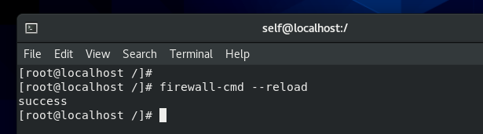
Allow in Firewall
Allow and Reload in Firewall
firewall-cmd --zone=public --add-port=161/udp –permanent
firewall-cmd --zone=public --add-port=161/tcp –permanent
firewall-cmd --zone=public --add-port=162/udp –permanent
firewall-cmd --zone=public --add-port=162/tcp –permanent
firewall-cmd --reload
06

